Slide 1
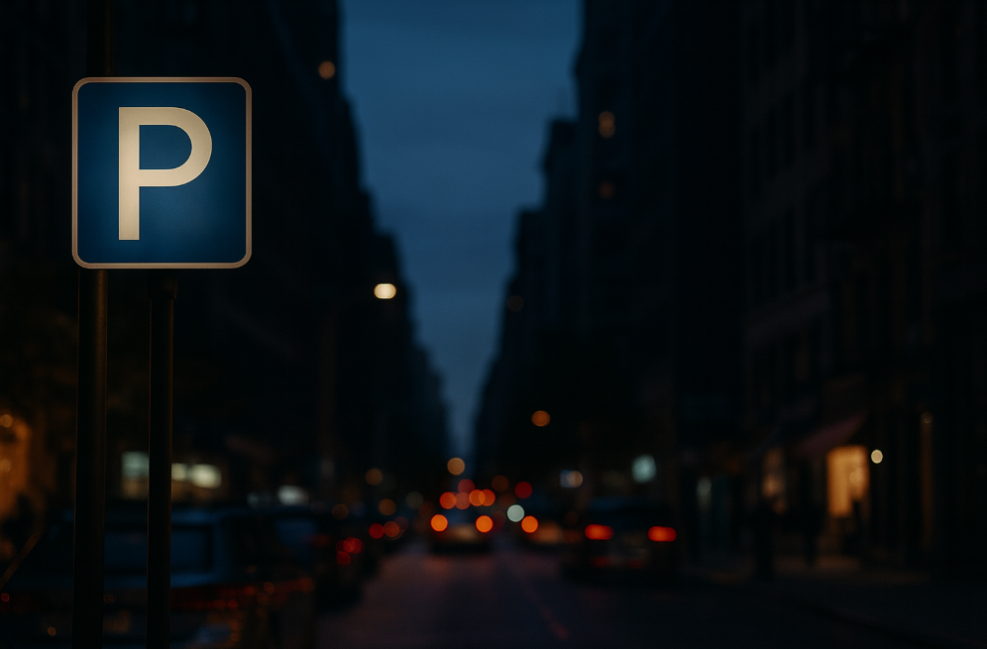
ParkScope
WazePark Assist
​
By Lior Yanwo
​

Slide 2
Motivating Use Case
"Detecting empty parking spaces by identifying what’s missing in the scene (no car in a valid curb segment).“
No navigation system predicts parking difficulty near the destination.
Saves time and reduces unnecessary loops around the area.
Improves navigation accuracy with smarter routing decisions.
Enhances user experience by suggesting nearby parking lots when needed.
PARKING LOT AVAILABLE 200m

Slide 3
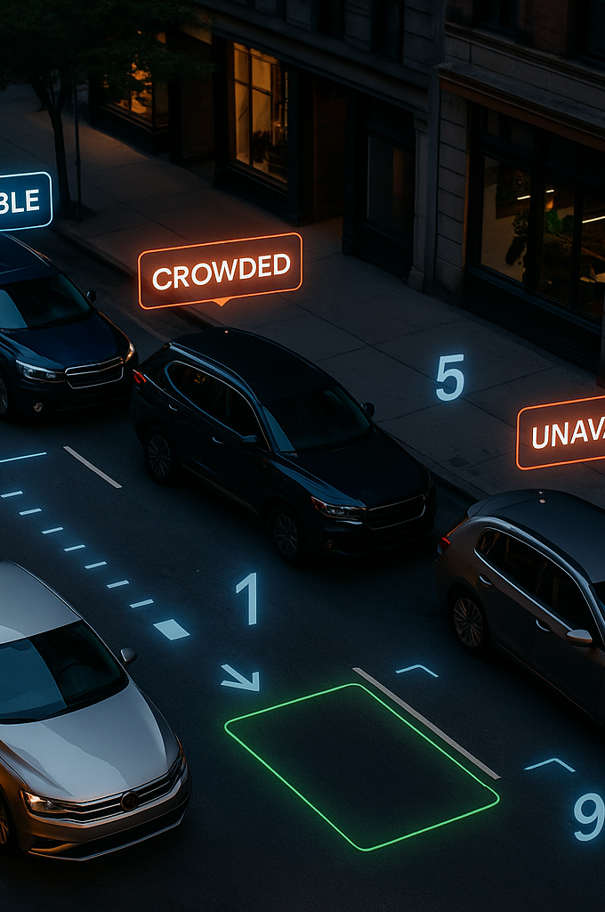
Project Task Description
First Output:
Secondary Output:
Input:
A single street image used to detect cars and find empty parking spaces after car removal.
A numeric score indicating how hard it is to find parking : 1 = easy, 10 = very difficult.
Bounding box of potential empty parking spaces (optional feature for future model).
Problem Type:
Novelty:
Detecting empty parking slots using a 'negative detection' strategy model searches for the absence of cars rather than their presence.
Car detection remove cars detect remaining curb availability.
Computer Vision – Detection + Regression

Slide 4
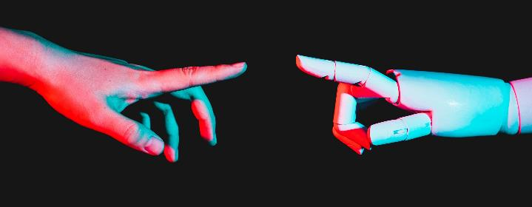
Models & Methods
PREPROCESSING — CAR DETECTION & EMPTY-SPACE EXTRACTION
• YOLO/DETR detects parked cars. • Cars are removed (masking). • Remaining curb areas are analyzed to find empty parking spaces.
BASELINE MODEL — XGBOOST REGRESSOR
• Uses numerical features: car count, curb length, density ratio. • Fast baseline for difficulty prediction.
DEEP LEARNING MODEL — RESNET50
• Learns visual patterns from full processed image. • Captures spacing, street width, shadows, crowding.
ADVANCED MODEL — VISION TRANSFORMER (ViT)
• Attention-based model for complex visual relationships. • Often outperforms CNNs in image regression tasks.

Slide 5
Data Specification
Data Sources:
• Public street-image datasets (Cityscapes, BDD100K). • Synthetic images created with GenAI. • Augmented variations (crop, lighting, weather, blur).
Data Types:
• Raw street images with parked vehicles. • Car detections from YOLO/DETR (bounding boxes). • Masked images after removing detected cars (empty-curb view). • Difficulty scores (1–10) generated automatically from parking density. • Numerical features for XGBoost (car count, curb length, density ratio). • Full processed images for ResNet & ViT.
Data Size:
• Small real-image set for baseline training. • Larger synthetic set for deep-model fine-tuning.

Slide 6
Metrics & KPIs
Metrics:
MAE
RMSE
Pearson Correlation
Measures accuracy of the predicted parking difficulty score.
Highlights larger prediction errors.
Measures alignment between model predictions and true density values
Difficulty Category Accuracy
(easy / medium / hard)
Evaluation Scope:
Compare XGBoost vs ResNet vs ViT.
Ablation: image-only vs feature-only models.
Real vs synthetic image performance.
Services / Future Use:
Potential Waze integration for smart rerouting.
Suggest nearest parking lot when predicted difficulty is high.

Slide 7

THANK U GOODBYE

